Slide 1
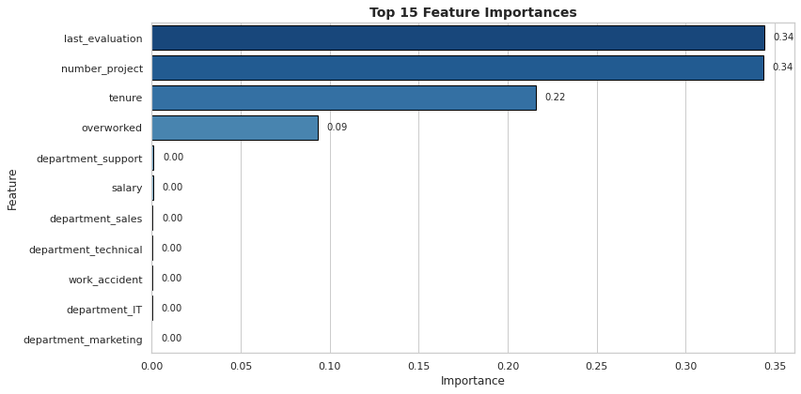
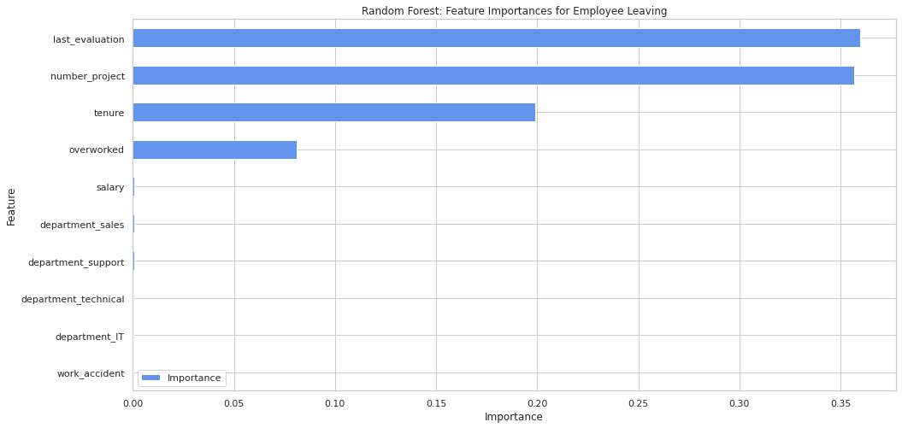
Smart HR Analytics: Employee Attrition Insights
Issues/Problem
Consulting firms face an average annual attrition rate of 20%, resulting in higher recruitment and training costs.
Understanding why employees leave is crucial for designing effective retention strategies.
Key Question: What are the most critical factors influencing employee turnover?
Response
Bar plot above shows the most relevant variables: ‘last_evaluation’, ‘number_project’, ‘tenure’ and ‘overworked’.
Predicted employee attrition using Random Forest (96% accuracy) and Logistic Regression (83% accuracy).
Key drivers included last evaluation score, tenure, workload, salary level, and work accidents.
Impact
Delivered actionable insights to reduce attrition by 10% over the next fiscal year.
Enabled HR teams to prioritize employees at risk of leaving.
Provided transparency on workload, leading to a 15% increase in employee satisfaction.
Reduced recruitment and onboarding costs by an estimated $200,000 annually.
The Random Forest model identified last_evaluation, tenure, number_project, overworked, salary_low, and work_accident as the most significant predictors of employee attrition.
Recommendation
Cap workload to a maximum of five projects per employee to prevent burnout.
Investigate dissatisfaction among four-year tenured employees for targeted improvements.
Reward employees consistently exceeding performance expectations to boost engagement.
Implement flexible workloads with transparent policies to ensure fairness.
Address potential data leakage by evaluating the impact of "last_evaluation" on predictions.
Use K-means clustering to identify employee patterns and tailor retention strategies.

